Slide 1
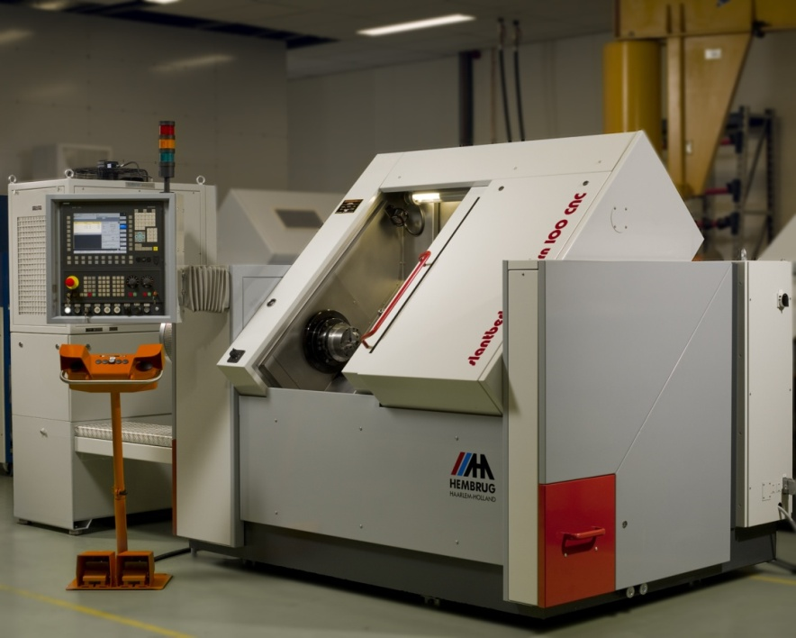
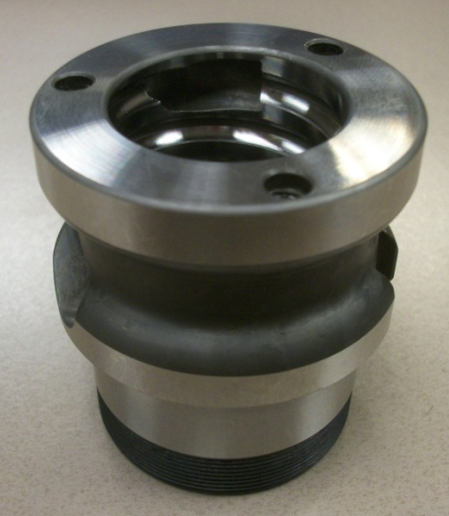
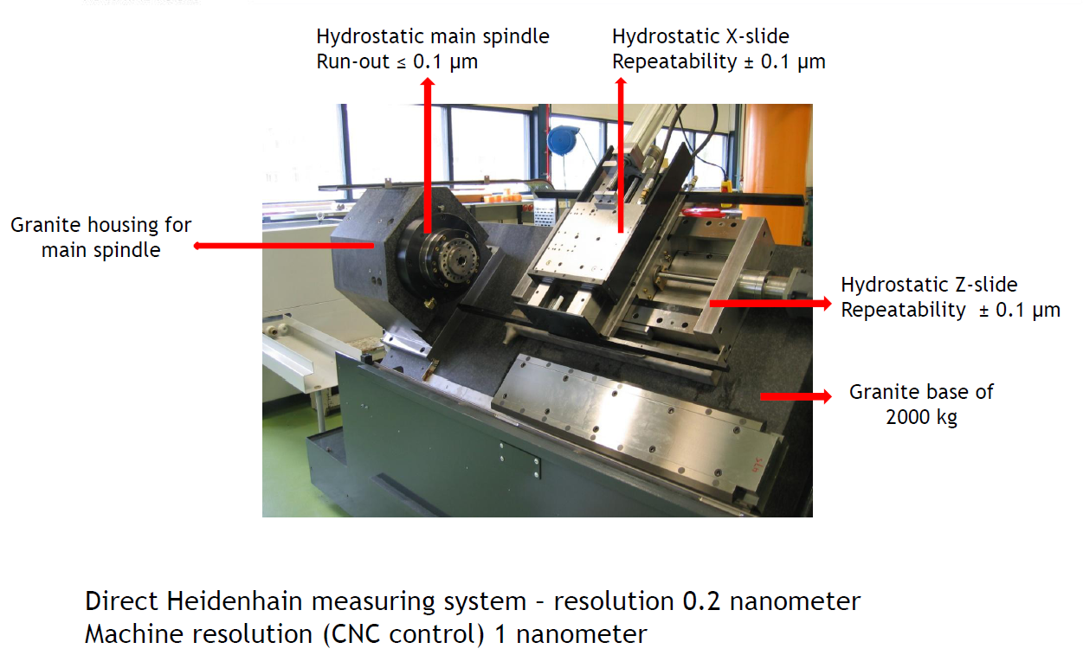

Advanced Manufacturing Engineering
REPS Ball Nut Hard Turning
Developing hard turning process to eliminate grinding of ball track
Advantages:
Reduced Capital Cost
Potential Capital Savings of $1.1 Million for REPS program with 450K/Year Volume
Reduced Noise Rejects
Potential Savings of $400 K /year for REPS program with 450K/Year Volume

Slide 2
Hard Turned Ball Nut Running Noise
Belt Drive Mesh Frequency
Belt Drive Mesh Frequency
Belt resonance?
Note 1: Harmonic spacing set to Ballnut defect frequency = 67.2Hz.
Note 2: Belt mesh frequency is 837Hz.

Slide 3
Hard turned ball nuts
Development machine to be installed at Ranger
Ability to make prototypes.

